Slide 1
5 Why report
( Problem: NE-1802V – Missing upper Styrofoam )

Slide 2
KABD
Missing upper styrene foam
1/10
Agenda :
1
Explain overview
Page : 2
2
Flow chart and history control
Page : 3
3
5W sheet : Analysis main cause and pass cause
Page : 4
4
Improvement action
Page : 5 → 9
5
Summary and schedule
Page : 10

Slide 3
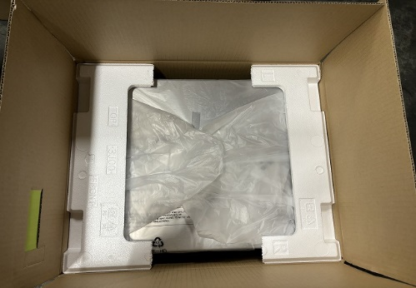
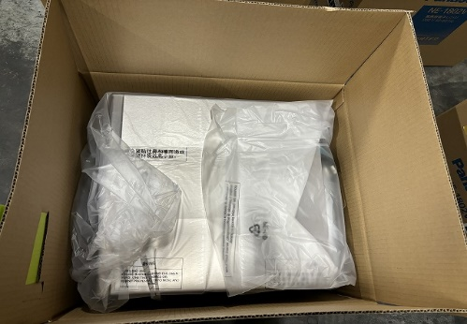
1
Missing upper styrene foam
2/10
Problem
: NE-1802V
: Missing upper Styrofoam
: 2/18pcs
[ in there 1pc PSNV information for KABD ]
: 7/Nov
: 12.Sep.2023
: No
: No
Model Name
Problem
NG Q’ty
Happen date
Pro date
4M changing
Rework/Repair
OK
NG
Missing Upper Styrofoam
Main cause
Happen cause :
Operator mistake ( operator forgot input to carton box)
Pass cause :
Regulation not enough to prevent mistake:
Set sample for weigh check regulation has risky → Weigh check can’t detect for 5pcs to setup.
Redundant material regulation not yet strongly to detect.
Action
Action for main cause:
Review all part weight can’t detect . Add item count 100% for part have risk missing and revise redundant rule in process
Add QR barcode into Styrofoam. (Suggestion)
Action for pass cause:
With 5pcs from beginning to setup weight standard for all lot apply double check for ensure have enough Styrofoam and other accessories.
Review redundant material of FA & MCS flow chart.
Separate weight product and accessory. (Suggestion)

Slide 4
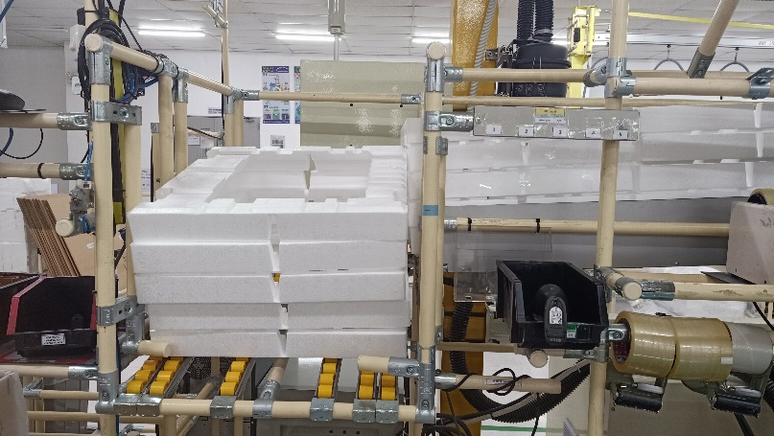
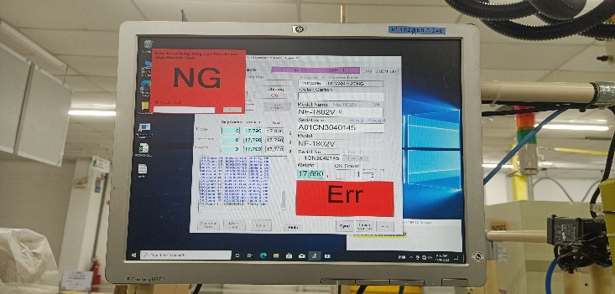
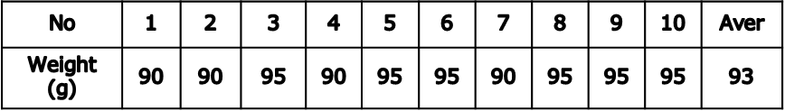
2
Flow chart and control method
3/10
Production process:
Happened process
Leak out process
Assembly
Function check
Appearance check
Packing
Weight check
Current control method:
Quantity control:
Upper Styrofoam : 5pcs
Tape : 5pcs
Std set up weight :
Upper : +70g
Lower : -70g
[ Tolerance base on CPK 2022]
Weight check of foam ➔ Can detect if missing
Rule setup weight check std :
Review log file :
Product | Weight (g) | Spec to judge
1st set | A | VC check by IPQC
2nd set | B | Aver(A,B)±70g
3rd set | C | Aver(A,B,C)±70g
4th set | D | Aver(A,B,C,D)±70g
5th set | E | Aver(A,B,C,D,E)±70g
1
Market claim
2
PSNV information
Applied for all lot

Slide 5
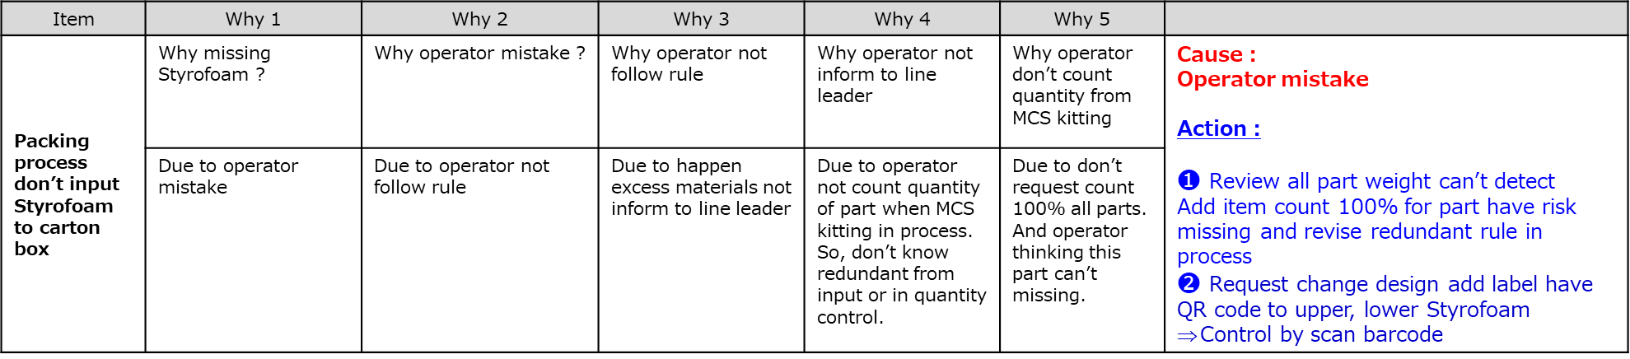
3
Why-Why analysis
4/10
Main cause : Operator don’t input Styrofoam in to carton box.
Item | Why 1 | Why 2 | Why 3 | Why 4 | Why 5
Packing process don’t input Styrofoam to carton box | Why missing Styrofoam ? | Why operator mistake ? | Why operator not follow rule | Why operator not inform to line leader | Why operator don’t count quantity from MCS kitting | Cause : Operator mistake Action : ❶ Review all part weight can’t detect Add item count 100% for part have risk missing and revise redundant rule in process $❷$ Request change design add label have QR code to upper, lower Styrofoam Control by scan barcode
 | Due to operator mistake | Due to operator not follow rule | Due to happen excess materials not inform to line leader | Due to operator not count quantity of part when MCS kitting in process. So, don’t know redundant from input or in quantity control. | Due to don’t request count 100% all parts. And operator thinking this part can’t missing.
Pass cause : Weight check can’t detect missing Styrofoam .
Item | Why 1 | Why 2 | Why 3 | Why 4 | Why 5 | Cause and Action
Weight check can’t detect missing Styrofoam | Why can’t weight check detect when missing Styrofoam? | Why is one of first five product of lot can’t detect ? | Why compare vs 1st product ? | Why check only 1st product for packing process? | Why packing process regulation only check 1pcs/lot? | Cause : Setup standard for weigh check regulation not yet strong to prevent mistake Action : ❸ With 5pcs from beginning to setup weight standard for all lot apply double check for ensure have enough Styrofoam and other accessories. ❹ Review redundant material of FA & MCS ❺ Strictly control packing part by weight check [ exclusion weight of product ]
 | Due to NG set is one of first five product of lot to take data to setup standard ➔ can’t detect | Due to NG set is second set of lot, have weight minus 70g vs first product. Tolerance setup of weight: Upper: +70g/ Lower: -70g ? | Due 1st product already double check by manual to ensure enough foam or all accessories by IPQC member | Due to regulation apply for all process to only check 1st product/lot. So, apply for packing process. | Due to regulation have risky need improvement.

Slide 6
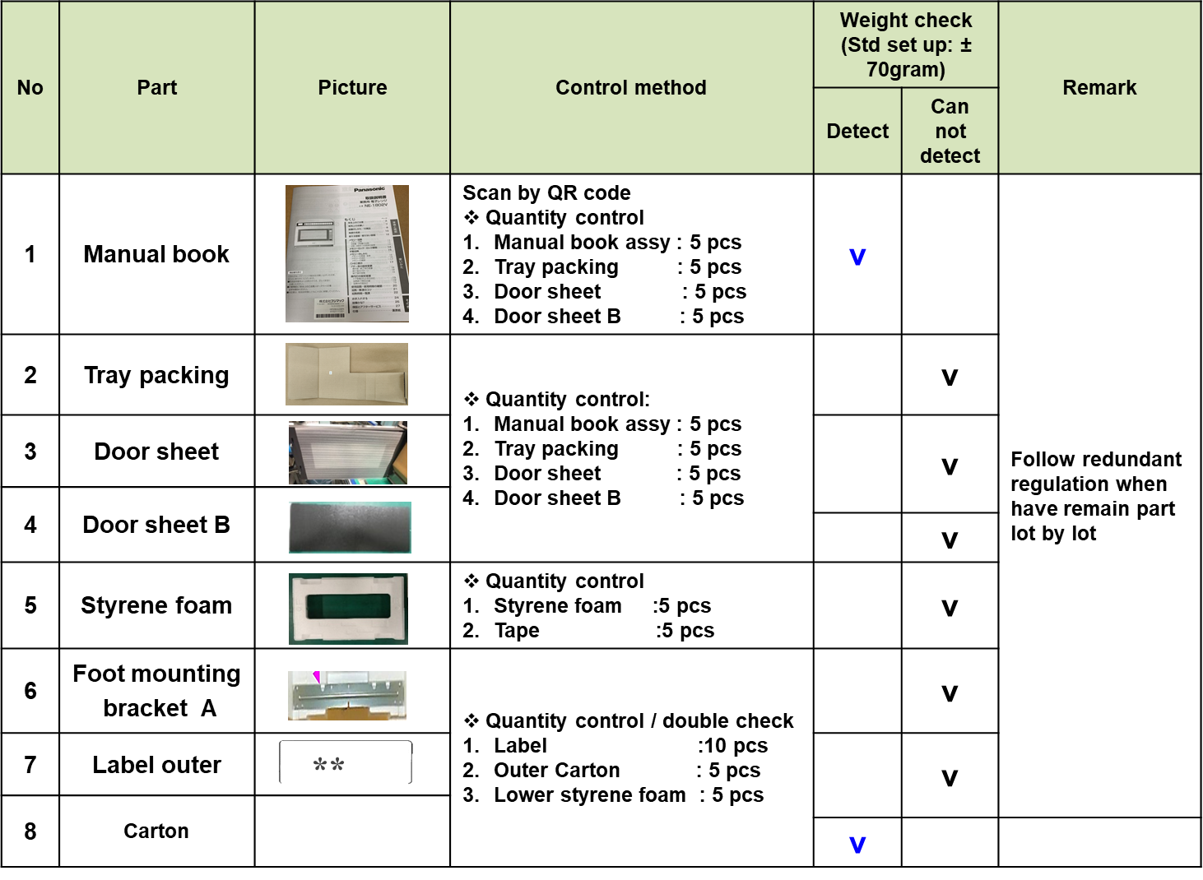
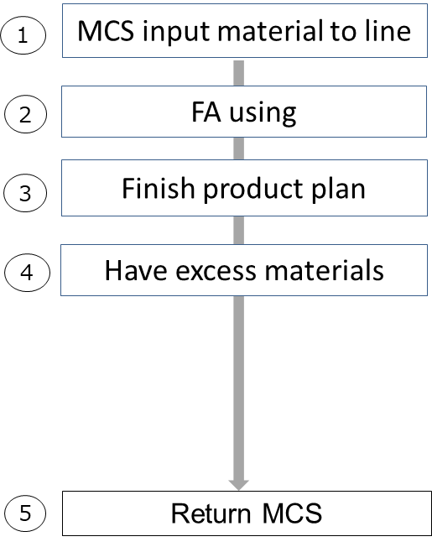
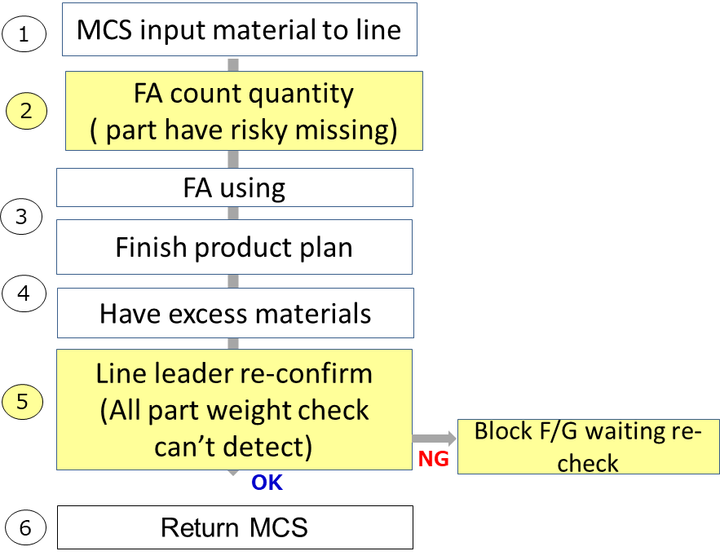
4
Action No.1
Improved Action / 改善対策
Action for Main Cause / 流出要因対策
5/10
Production Flow chart :
Total have 6/8 parts can missing & current q’ty control by manual
Prepare
Some part can detect at function check if missing
Assembly
Function check
Appearance check
Review all accessories can’t detect by checker
◆Before
◆ After
Not yet have regulation for operator counter 100% accessories.
And when have excess material, L.LD no check again
Add item request operator counter 100% accessories from MCS kitting.
Revise regulation solve when excess material, L.LD re-check WIP and block FG waiting confirm.
Packing
Weight check
If have remain part
➔ Block to recheck
Applied : 15.Nov

Slide 7
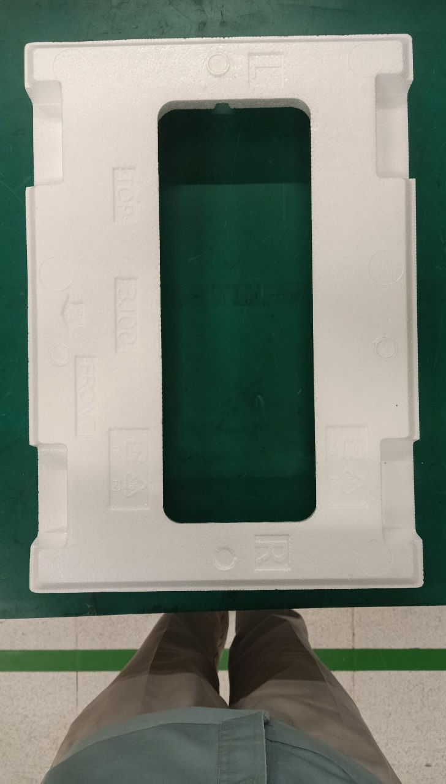

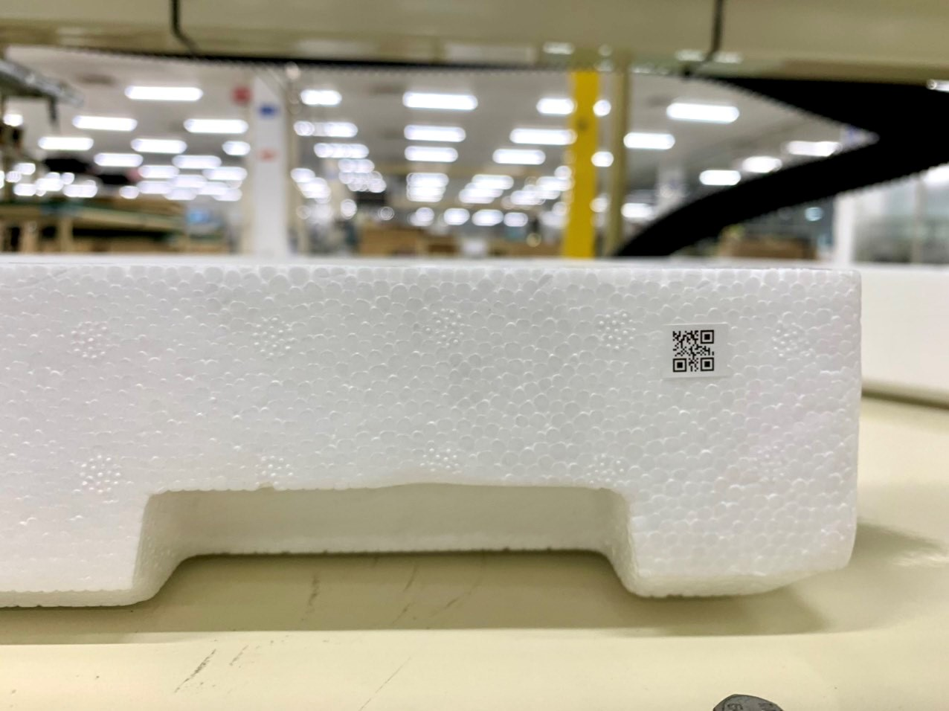
4
Action No.2 : Suggestion
Improved Action / 改善対策
Action for Main Cause / 流出要因対策
6/10
Discus vs KABD to add QR code on Styrofoam and control by scan QR code
◆Before
◆ After
Add QR code
Request apply for 5 parts below
Current control method :
Do not have QR code and control by manual
➔ Control by manual and happen missing foam.
Improvement control method :
Discuss vs KABD to change design: Add QR code to control. (QR code inhouse)
➔ Control Foam & some part by scan QR code
Schedule : Under discuss

Slide 8
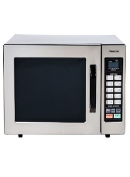
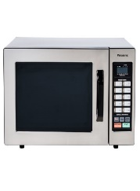
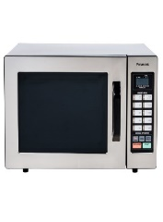

4
Action No.3
Improved Action / 改善対策
Action for Pass Cause / 流出要因対策
7/10
Add IPQC double check 5 pcs to setup weight standard
◆Before
◆ After
Product 1
Product 2
Product 3
Product 4
Product 5
Packing
Packing
Product 1
Product 2
Product 3
Product 4
Product 5
NG
IPQC double check 5 pcs setup weight standard
IPQC check first product
Don’t double check
Current control method :
Only sampling check 1st product .
But setup weight check need to data of 5pcs.
➔ If one in five product missing foam ➔ Take wrong spec all of lot.
Improvement control method :
Sampling check 5pcs from beginning to setup weight standard for all lot
➔ Ensure 5pcs enough foam and other accessories.
Applied : 15.Nov

Slide 9
4
Action No.4
Improved Action / 改善対策
Action for Pass Cause / 流出要因対策
8/10
Revise redundant part solving flow chart and applied for all cats (apply for out SAP)
◆Before
◆ After
1. Have redundant at FA line
Daily
L. Leader
1. Have redundant at FA line
Daily
L. Leader
2. Separate out line
Daily
L. Leader
2. Separate out line
Daily
L. Leader
3. Collect to FA warehouse
Daily
FA Material member
3. Collect to FA warehouse
Daily
FA Material member
4. Return MCS
Weekly
FA Material member
4. Return MCS
Daily
FA Material member
5. Keep & Scrap
Monthly
MCS
member
5. Keep & Scrap
Monthly
MCS
member
Current control method :
Return redundant part to MCS on 1 time/ week.
Not issue check list or transfer list to control / scrap
➔ Don’t have history data to check again
Improvement control method :
Return redundant part to MCS on daily.
Issue check list and transfer list to control / scrap
➔ Have history data to check again
Applied : Oct

Slide 10
4
Action No.5 : Suggestion
Improved Action / 改善対策
Action for Pass Cause / 流出要因対策
9/10
Strictly control packing part by weight check [ exclusion weight of product ]
◆Before
◆ After
Function check
Weight check
Add
Prepare
Assembly
VC check
Packing
Weight check product
Link
Weight check accessory
Prepare
Assembly
Function check
Appearance check
Packing
Risk
Weight check full product
Test separate weight of product & packing part
Weight check product
Weight check accessory
= Weight total-weight check product
Have diff gap between product vs packing part very big
➔ Setup spec can’t detect 100% when missing part
Current control method :
Using only one process to weight check, combine all accessory and setup lower / upper limit have big gap
➔ If missing part have weight under lower limit can’t detect
Improvement control method :
Addition one weight check and separate accessories vs product. Take lower / upper limit have small gap.
➔ Prevent missing part.
Schedule : Under discuss

Slide 11
5
Summary improvement and schedule
10/10
Plan
Act
No | Line | Issue | Countermeasure | PIC | Nov |  |  |  |  | Dec | Judge
 |  |  |  |  | W1 | W2 | W3 | W4 | W5
1 | All FA line | Some part at weight check can’t detect | Review all part weight can’t detect and issue regulation control redundant part. | FA |  |  |  |  |  |  | Done
2 | All FA line | Check only 1st product and at packing process take data to setup spec of 5pcs | Sampling check 5pcs from beginning to setup weight standard for all lot | FA |  |  |  |  |  |  | Done
3 | All cats | Return redundant part to MCS on 1 time/ week and don’t have control list | Revise redundant part solving flow chart and applied for all cats (apply for out SAP) | FA/ MCS |  |  |  |  |  |  | Done
4 | All FA line | Don’t have QR code and only control by manual ➔ Operator can forget | Request change design add label have QR code to upper, lower Styrofoam Control by scan barcode | FA/ FE |  |  |  |  |  |  | Under discuss
5 | All FA line | MW product is heavy and many accessories, difficult to take lower and upper limit to prevent missing all accessories | Strictly control packing part by weight check [ exclusion weight of product ] | FA/ PE/ PIS |  |  |  |  |  |  | Under discuss

